Slide 1
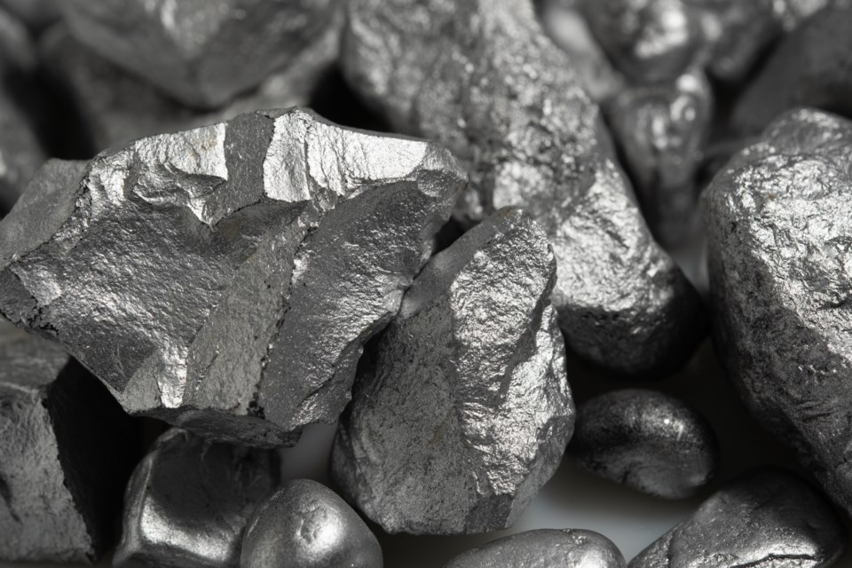
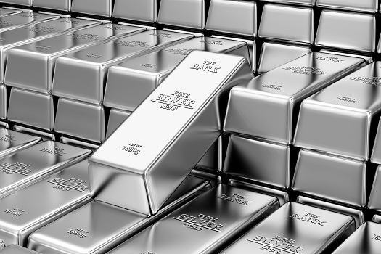
Silver the Devil’s Metal
Alex Feeley

Slide 2
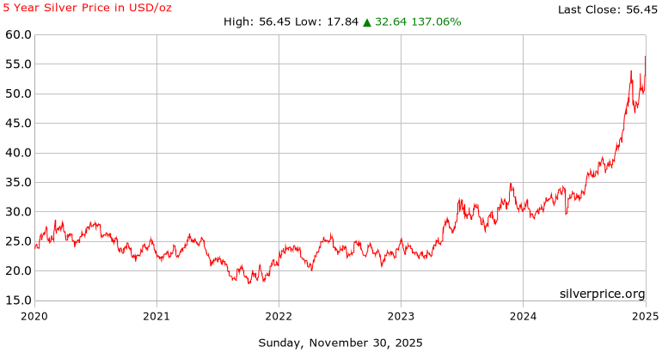
What's New in 2025
Silver has increased 71% in 2025
Silver has hit it’s all time high with renewed interest in investment

Slide 3
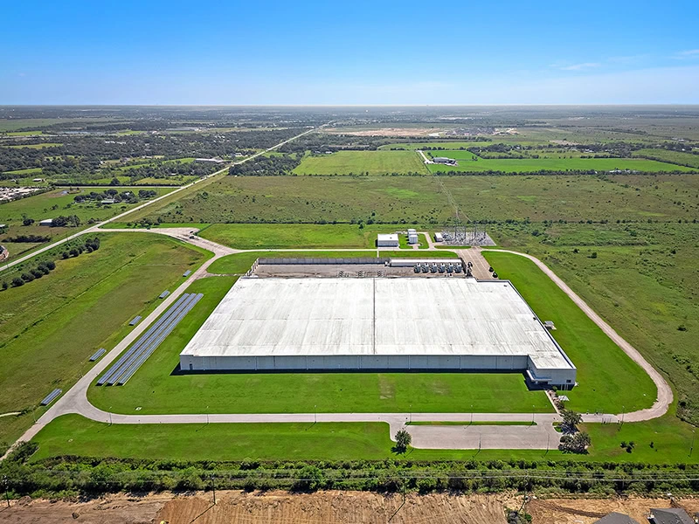
What's causing this Renewal
High demand from industries:
Used in solar panels, electric cars, and electronics.
Low supply:
Silver mines aren’t producing enough to keep up.
Falling inventory:
Storage vaults have much less silver than in past years.
Investors buying in:
People are turning to silver as a safe investment during uncertain economic times.

Slide 4
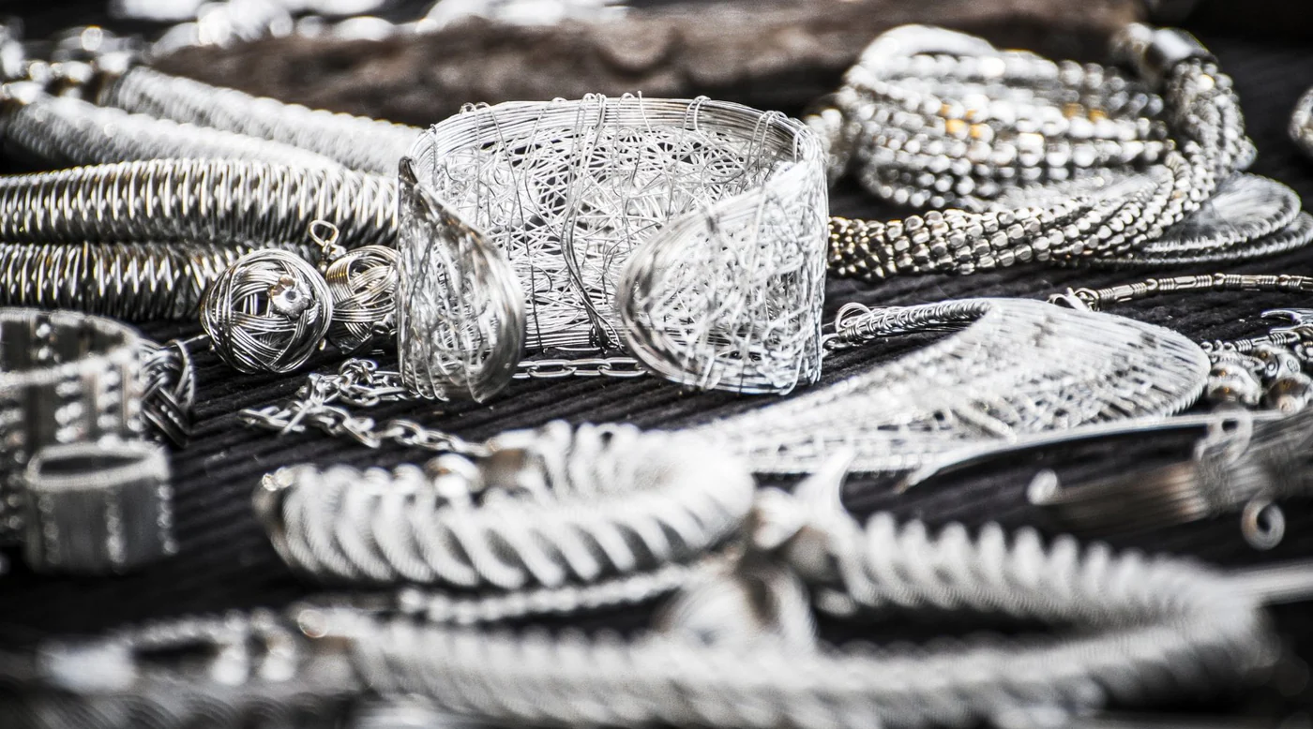
What this Means for Silver
Silver’s price is rising because companies need it and people want it as an investment.
This combination doesn’t happen often which is why the price is setting records.
Analysts say the trend may continue if demand stays strong.

Slide 5
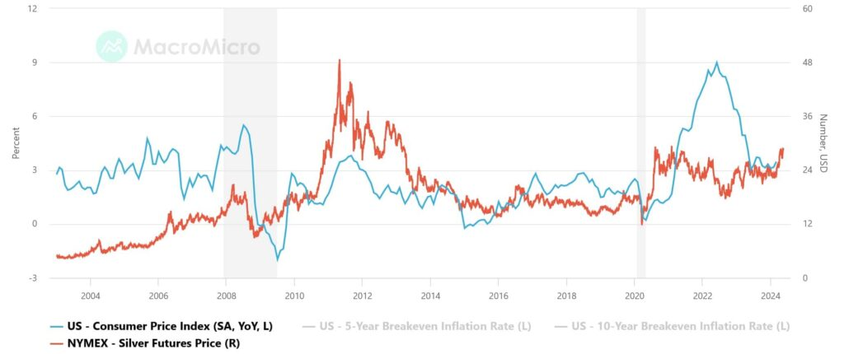
Questions for the Future
Will silver mines be able to produce more?
Will demand from solar and EVs keep growing?
Could the price drop if the economy changes?

Slide 6


Slide 7
Article
https://www.cnbc.com/2025/11/29/silver-hit-record-highs-in-2025-and-still-has-further-to-run.htm

